Slide 1


Huazhong University of Science and Technology
The Department of Electronics and Information Engineering
Electronic Circuit Analysis and Design
Dr. Tianping Deng
Email: dengtp@hust.edu.cn

Slide 2
Contents
PART 1 SEMICONDUCTOR DEVICES AND BASIC APPLICATIONS
Chapter 1 Semiconductor Materials and Diodes
Chapter 2 Diode Circuits
Chapter 3 The Field-Effect Transistor
Chapter 4 Basic FET Amplifiers
Chapter 5 The Bipolar Junction Transistor
Chapter 6 Basic BJT Amplifiers
Chapter 7 Frequency Response
Chapter 8 Output Stages and Power Amplifiers
PART 2 ANALOG ELECTRONICS
Chapter 9 Ideal Operational Amplifiers and Op-Amp Circuits
Chapter 10 Integrated Circuit Biasing and Active Loads
Chapter 11 Differential and Multistage Amplifiers
Chapter 12 Feedback and Stability
Chapter 13 Operational Amplifier Circuits
Chapter 14 Nonideal Effects in Operational Amplifier Circuits
Chapter 15 Applications and Design of Integrated Circuits
Chapter 15 Applications and Design of Integrated Circuits

Slide 3
Chapter 15: Applications and Design of Integrated Circuits
15.0 Preview
15.1 Active Filters
15.2 Oscillators
15.3 Schmitt Trigger Circuits
15.4 Nonsinusoidal Oscillators and Timing Circuits
15.5 Integrated Circuit Power Amplifiers
15.6 Voltage Regulators
15.7 Summary

Slide 4
15.0 Preview
We consider additional applications and designs of amp.
We consider comparator circuits
Objectives
To analyze and design the active filters.
To analyze and design the oscillators and make an amp operate as an oscillator.
To discuss the basis of voltage regulator circuits.

Slide 5
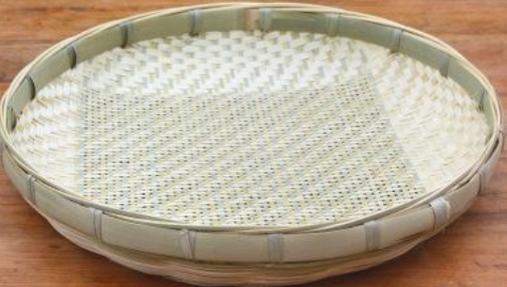
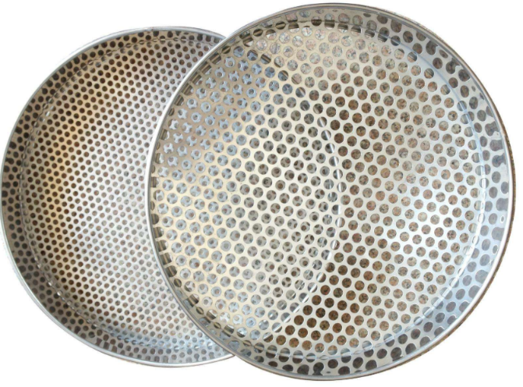

15.0 Preview

Slide 6
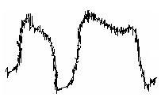
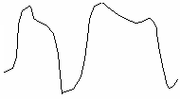

FET
BJT
Op-Amp

Slide 8
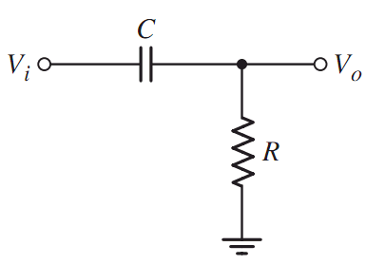
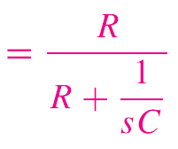
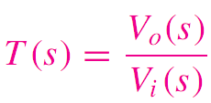
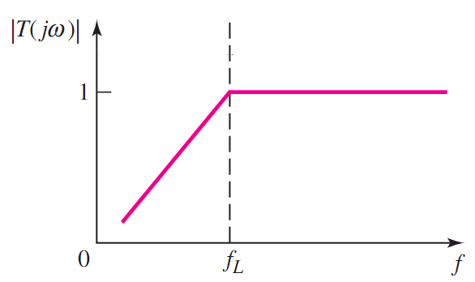
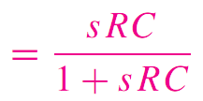


High pass or low pass?
T (s)=?
High pass filter
cutoff frequency
One zero
One pole

Slide 9
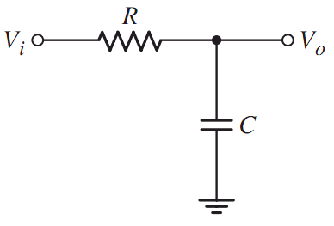
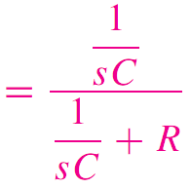
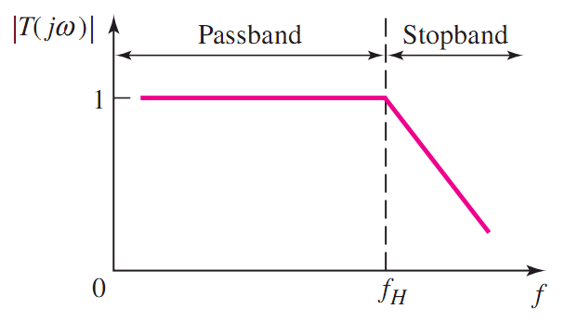
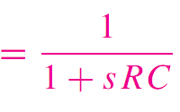
High pass or low pass?
T (s)=?
cutoff frequency
no zero
One pole
Low pass filter

Slide 10
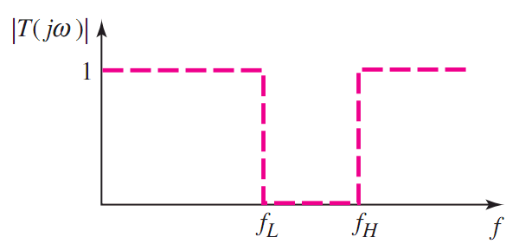
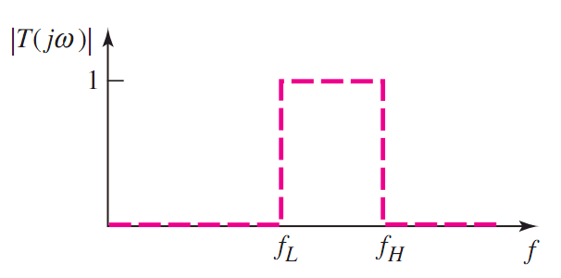



Slide 11
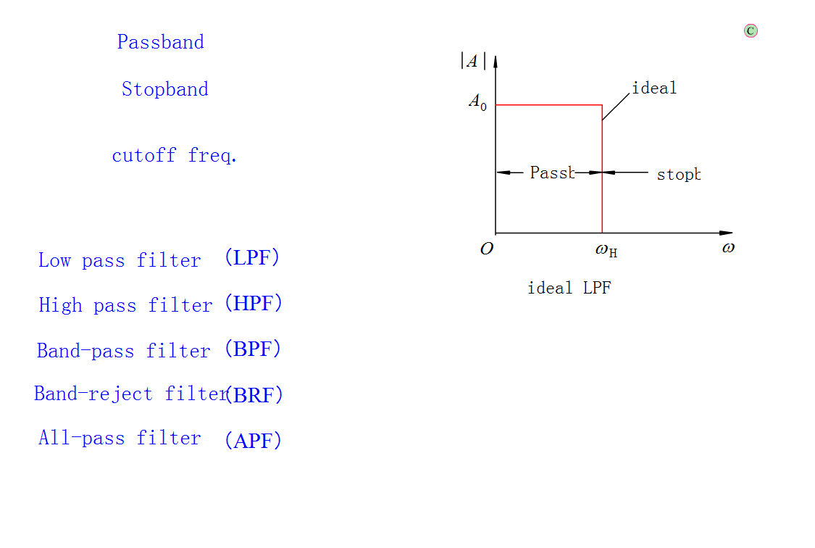

Slide 12
The shortcomings of this circuit：
1、The output is loaded down
when used to drive load.
2、No amplification
3、Characteristics are not ideal,
the edge is not steep.

Slide 13
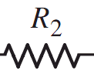
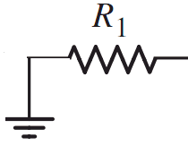
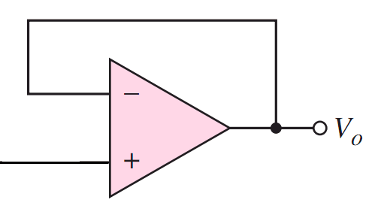


No amplification
1＋R₂/R₁

Slide 14
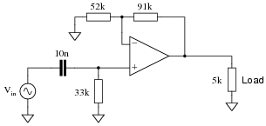
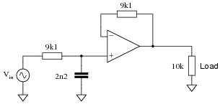
Think?
Determine the type (LP, HP, BP, BS) and cutoff frequency of
this active filter circuit?
High pass
Low pass

Slide 15
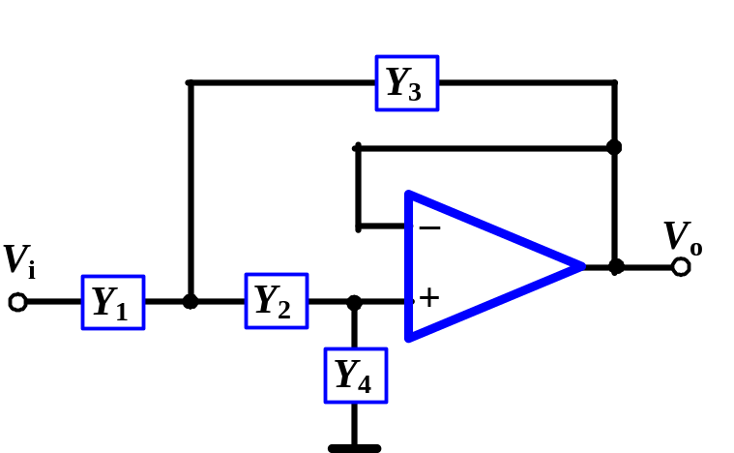
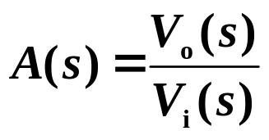
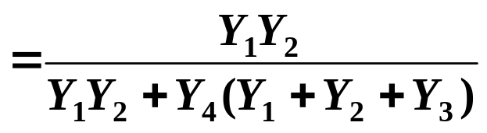

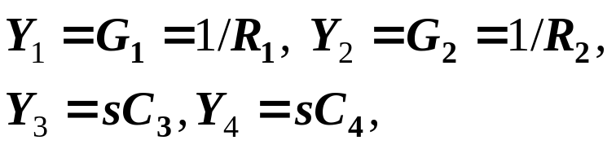
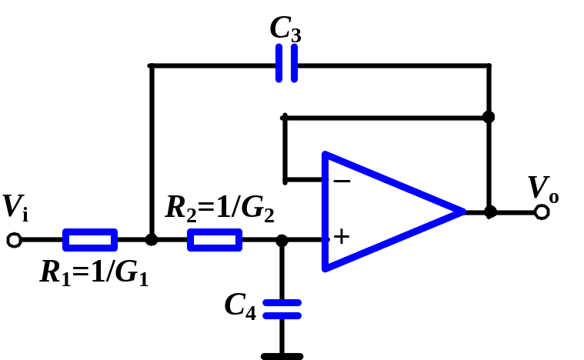
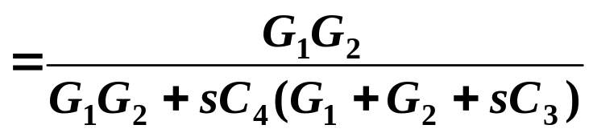
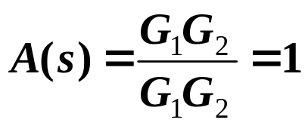



15.1.2 General Two-Pole Active Filter
Transfer function
Set
Transfer function becomes
When
Neg. or Pos.
Feedback?
Neg. or Pos.
Feedback?
Circuit acts as a low-pass filter.

Slide 16
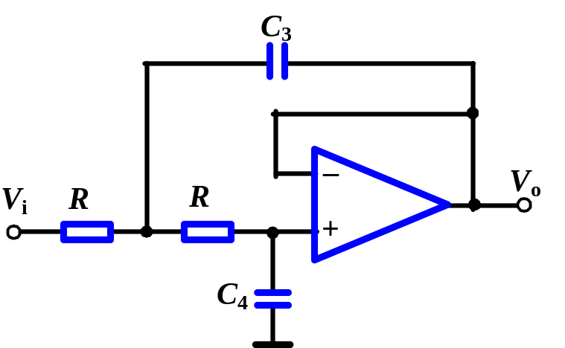
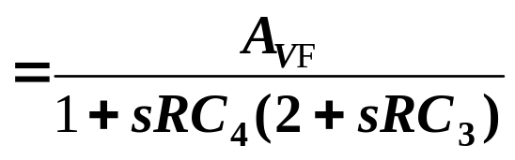


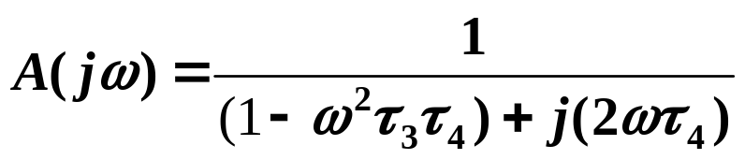
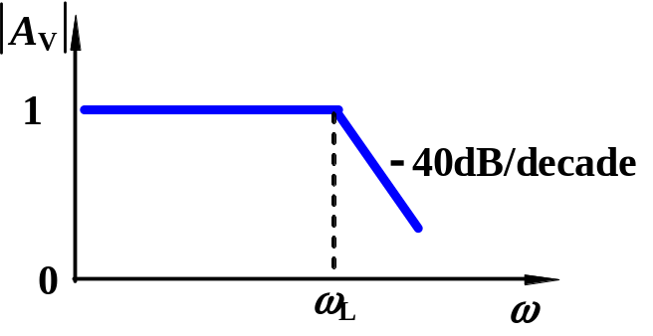
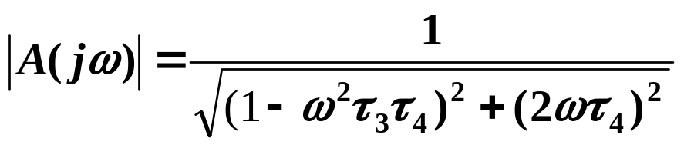
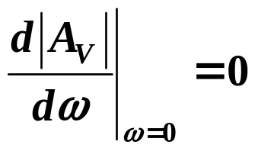
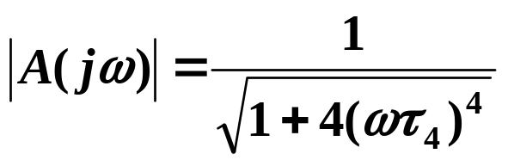

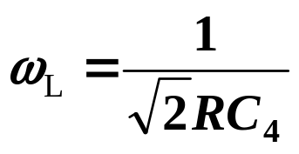
15.1.3. Butterworth Low-Pass Filter
Transfer function
Define
Set
For a maximally flat filter
Cutoff Frequency

Slide 17
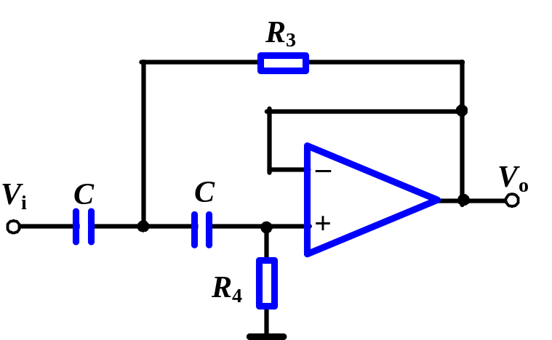
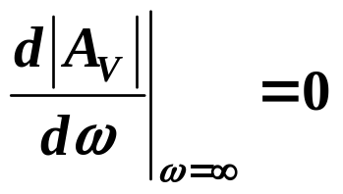

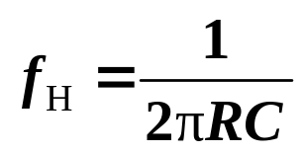
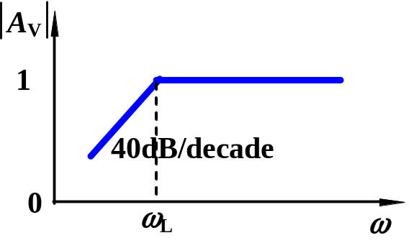

15.1.4. Two-Pole Butterworth High-Pass Filter
The R and C are interchanged from those in the low-pass filter.
Cutoff Frequency

Slide 18

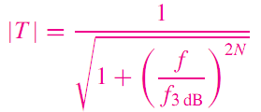
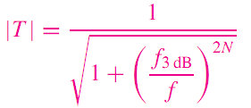
15.1.5 Higher-Order Active Filters

Slide 19
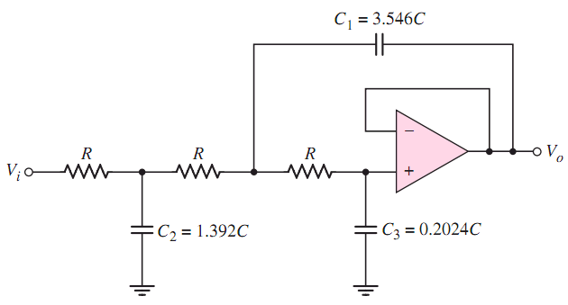
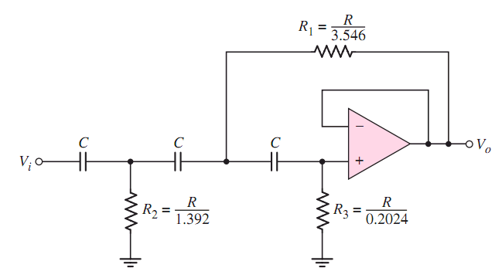
Low pass or high pass?

Slide 20
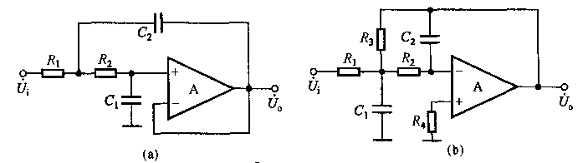
Example 2
The circuit is shown as figure, explain the filter is LPF or HPF, and
then determine the pass-band gain of the circuit.

Slide 21
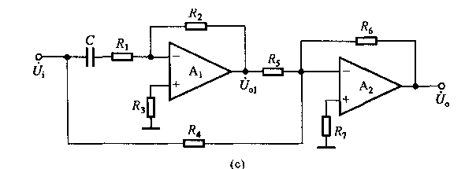
Example 2
The circuit is shown as figure, explain the filter is LPF or HPF, and
then determine the pass-band gain of the circuit.

Slide 22
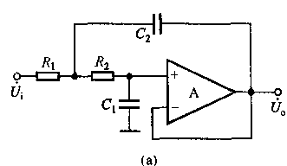
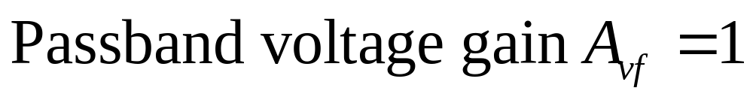
Example 2
If the frequency is equal 0Hz.
The capacitor is equivalent to open.
Voltage follower

Slide 23
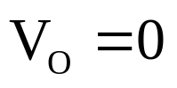
Example 2
If the frequency is tend to be infinite.
The capacitor is equivalent to short.
The output voltage is zero.
So the circuit is a LPF.

Slide 24
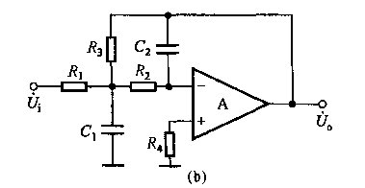


Example 2
If the frequency is equal 0Hz.
The capacitor is equivalent to open.
Inverting Amplifier

Slide 25

Example 2
If the frequency is
tend to be infinite.
The capacitor is
equivalent to short.
So the circuit is a LPF.

Slide 26


Example 2
The op-amp A₂ and R₄ ,R₅ and R₆ consist
of a summing opposite voltages

Slide 27


Example 2
If the frequency is equal 0Hz.
The capacitor is equivalent to open.

Slide 28



Example 2
If the frequency is tend to be infinite.
The capacitor is equivalent to short.
So the circuit is a LPF.

Slide 29

Example 3
The circuit is shown as figure 5-2, assume the op-amp is ideal,
1) Explain the configuration of A₁,R₁,C₁,R₃ and R₄.
2)Explain the configuration of A₂, C₂ and R₂.
3)If the magnitude freq. response of the circuit is shown as figure
5-3, find out the value of the capacitor C₁ and the resistor R₂.
First-order active LPF
First-order active HPF

Slide 30




Example 3

Slide 31



Example 3

Slide 32
Questions
and
Answers

